Slide 1



Introduction to GIT
Presenter: Le Van Nhat Truong

Slide 2
Agenda
What is Version Control System (VCS) ?
What about GIT
Working flow showcase - Command
Using Forking workflow in project

Slide 3
1. What is the Version Control System (VCS)?
Version control systems are a category of software tools that help a software team manage changes to source code over time.
Keep track of every modification in special kind of database.
Version control protects source code from both catastrophe and the casual degradation of human error and unintended consequences.
In all software development, any change can introduce new bugs on its own and new software can't be trusted until it's tested.

Slide 4
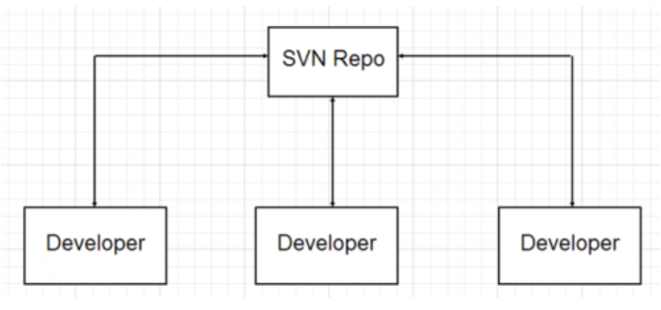
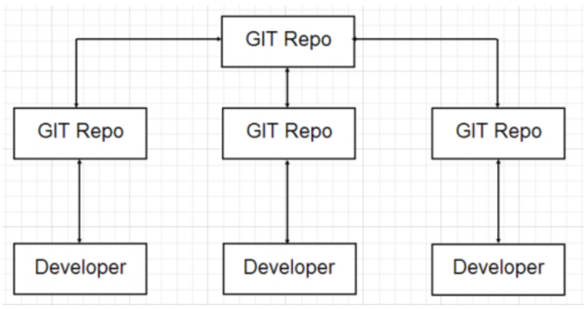
1. What is the Version Control System (VCS)?
Centralized VCS (SVN) Access a single central repository Reach every developer before committing new change (may be broken code). Working offline changeling (only “one” true repo) Speed (slow) This not in case of CVSC | Distributed VCS (Git) - Every developer has his/her own copy of the repository - Developers can work offline (can commit, branch, merge branches, view history, anything they need) give flexibility. - Speed (fast) - Some time developers may work for to long in isolation(not update) this is not a good thing.

Slide 5

2. What about GIT?
GIT is a free and open source Distributed VCS originally developed in 2005 by Linus Torvalds.
Encourages the use of branches
Git itself provides only command line tools (UI created on top of it by other company: GitHub, Atlassian’s SourceTree, etc.)

Slide 6
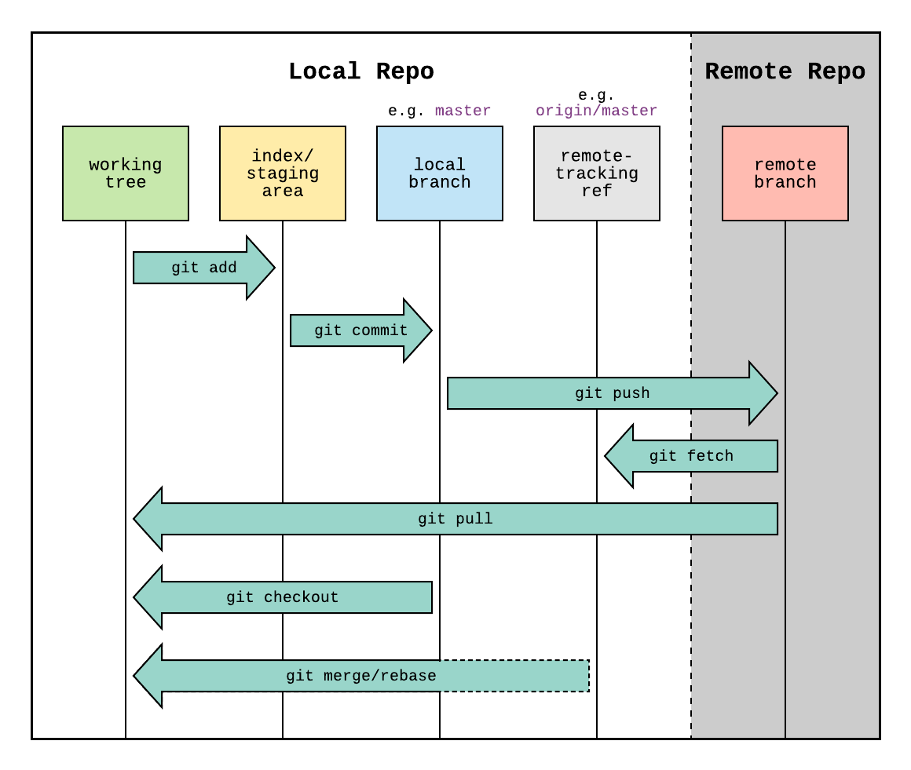
3.1 Git workflow diagram showcasing

Slide 7
3.2 Git command
Git pull and fetch
$ git pull [<options>] [<repository> [<refspec>…​]]
$ git fetch [<options>] [<repository> [<refspec>…​]]
git pull = git fetch + merge (default)
git pull = git fetch + rebase (adding --rebase)
➔ git fetch really only downloads new data from a remote repository - but it doesn't integrate any of this new data into your working files, never manipulate, destroy, or screw up anything.

Slide 8
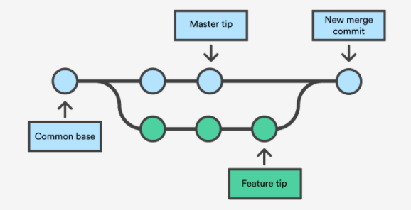
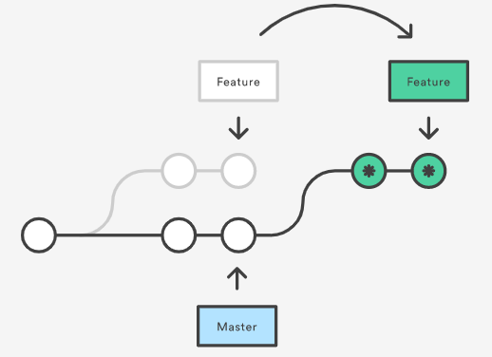
3.2 Git command
Git merge $ git merge [--option] [branch-name] Combine commits following timeline and create a new merge commit. Preseves history Complex history | Git rebase $ git rebasae [--option] [branch-name] - Move all the changes in feature branch starting from the last commit of the master branch. - Rewrite history - Get a much cleaner project history (make easier for interactive rebase) - The golden rule of git rebase is to never use it on public branches.

Slide 9
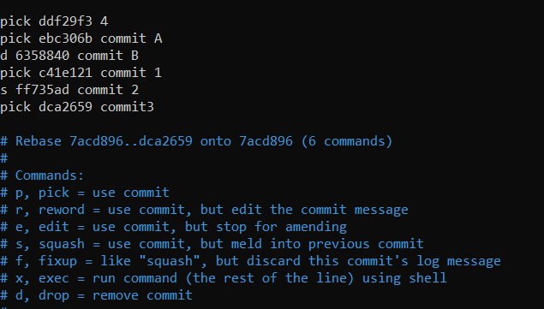
3.2 Git command
Git interactive rebase
$ git rebase -i HEAD~n (n is a number of last commit to interactive)
Copy commit
$ git cherry-pick [commitSha]
Carefully to avoid duplicate commit.

Slide 10
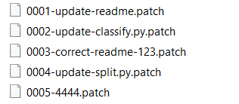
3.2 Git command
Git patch file
$ git format-patch –x
$ git format-patch -x --stdout > name.patch
$ git apply file.patch
$ git am file.patch
- Patch is a text file, whose contents are similar to Git diff, but along with code, it also has metadata about commits.
- It useful when the developer does not have write access to the repository.
- Condition to apply: the applied branch and the patch file have same starting point of code.

Slide 11
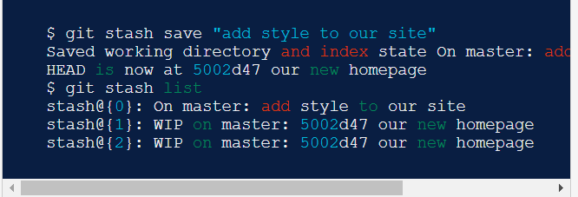
3.2 Git command
Git Stash
$ git stash
$ git stash save “your message"
$ git stash pop stash@{index}
$ git stash show stash@{index}
Git stash temporarily shelves (or stashes) changes, and then come back and re-apply them later on. (and can apply on other branch on local repo)
It useful when you need to quickly switch context and work on something else but not ready to commit this changes.

